Slide 1


Project Leadership , Ethics , Closing Project

Slide 2
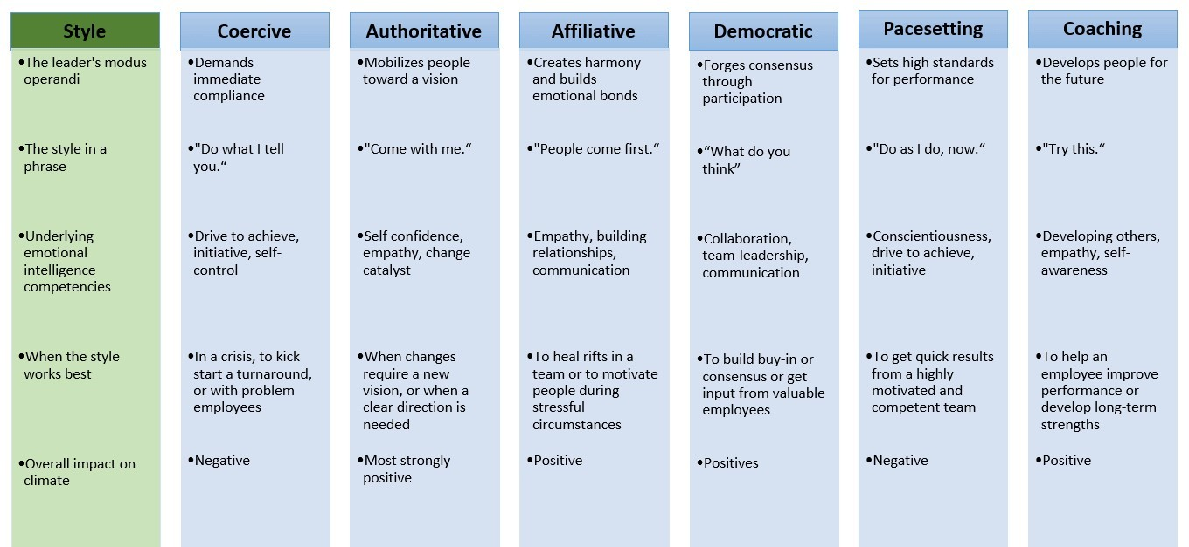

Slide 3



in project management

Slide 4

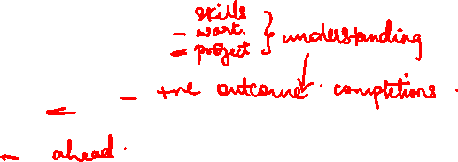
Common Ethical Dilemmas
Human resource situations
Conflicts of interest
Confidence
Corporate resources

Slide 5


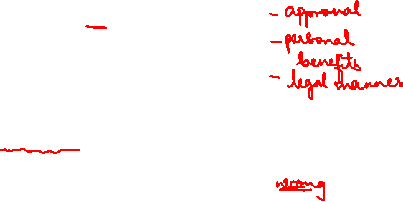
Recognize key concepts related to business ethics
Identify examples of ethical dilemmas in project management
Recognize the benefits of managing ethics in your project
Identify the aims of the PMI code of ethics and professional conduct
Recognize key issues in the development of a code of ethics for project management
Match examples to the types of inappropriate behaviour they represent
Identify the true statements about the PMI process to review ethics complaints
Identify the aims of the PMI ethics complaints review process
The Role of Ethics in Project Management

Slide 6


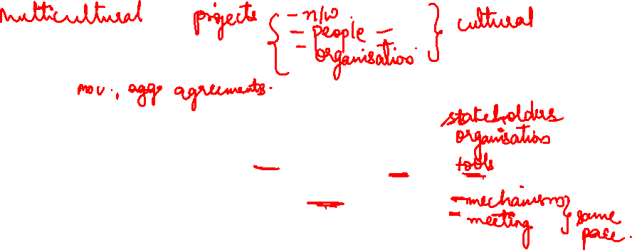
Multicultural projects
Problems with multicultural project
Different definitions of milestone and handoff
Uneven project communication and reporting
Uneven Ability to use project tools

Slide 7



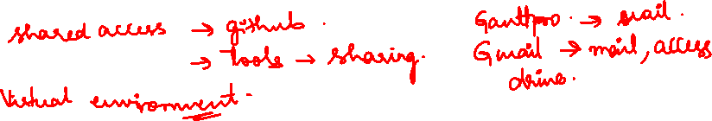
Virtual project
Tool and technology for virtual project ??

Slide 8


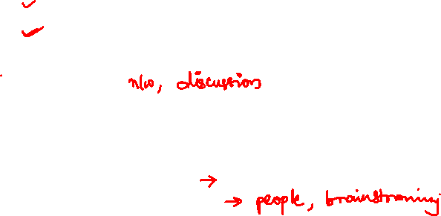
Benefits of virtual project
Larger talent pool
Cost effective
Help managers an employee grow
Virtual project
Challenges in virtual budget
Time differences
Miscommunication
Disconnection to the team

Slide 9



Closing the project

Slide 10
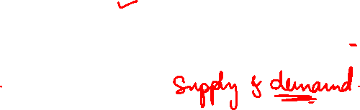
All Things Come to an End . . .
Termination rarely has much impact on technical success or failure . . .
But a huge impact on other areas
Residual attitudes toward the project (client, senior management, and project team)
Success of subsequent projects
So it makes sense to plan and execute termination with care 13

Slide 11
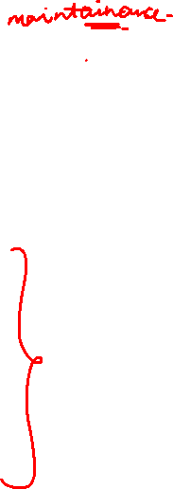
When Do Projects Terminate?
Upon successful completion, or . . .
When the organization is no longer willing to invest the time and cost required to complete the project, given its current status and expected outcome.
Most Common Reasons for Projects Termination
Low probability of technical/commercial success
Low profitability/market potential
Damaging cost growth
Change in competitive factors/market needs
Irresolvable technical problems
Higher priority of competing projects
Schedule delays

Slide 12

Close-out Plan
Questions to be Asked
What tasks are required to close the project?
Who will be responsible for these tasks?
When will closure begin and end?
How will the project be delivered?

Slide 13



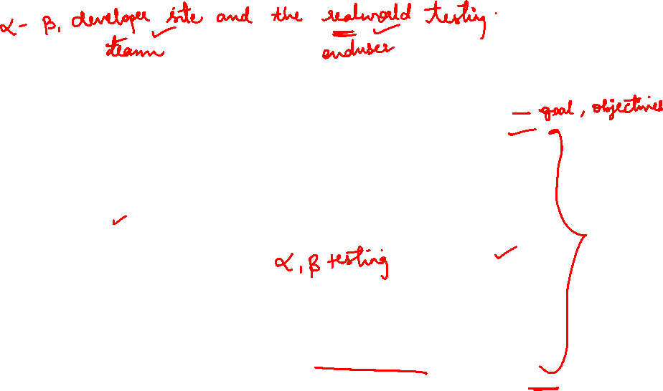
Complete your deliverables
Customer Acceptance
Perform acceptance testing
Gain customer acceptance

Slide 14


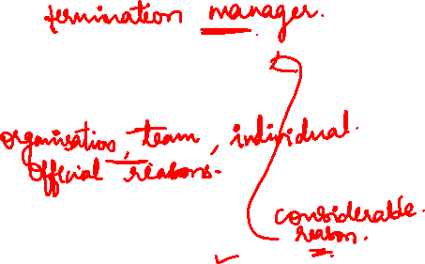
Steps to avoid negative consequences on project termination
project termination
Reasons for project termination

Slide 15
Extinction
Types of project termination
Addition
Integration
Starvation

Slide 16
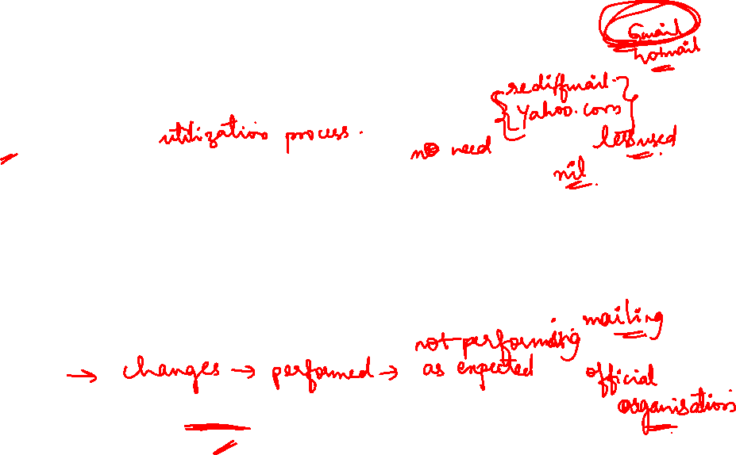
Various types of project termination
Termination by Extinction
The project is stopped.
It may end because it has been successful and achieved its goals:
The new product has been developed and handed over to the client, or the software has been installed and is running.
The project may also be stopped because it is unsuccessful or has been superseded
A special case of termination by extinction is “termination by murder.
There are all sorts of murders.
Termination by Addition
The project becomes a formal part of the parent organization
People, material, facilities transition

Slide 17
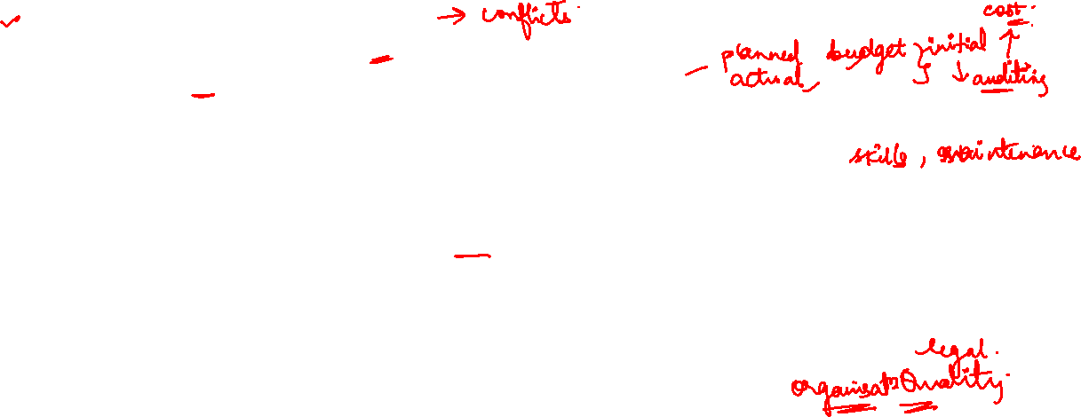
Various types of project termination
3 Termination by Integration
The more important aspects of the transition from project to integrated operation that must be considered when the project functions are distributed.
Personnel :Where will the project team go?
Manufacturing: Is training complete?
Accounting/Finance Have the project accounts been closed and audited?
Engineering Are all drawings complete and on fi le? Are operating manuals and change procedures understood? Have training programs been altered appropriately for new employees? Have maintenance schedules been adjusted for the change? Do we have a proper level of “spares” in stock?
Information Systems/Software Has the new system been thoroughly tested? Is the software properly documented and are “comments” complete?
Marketing Is the sales department aware of the change? Is marketing in agreement about lead times? Is
marketing comfortable with the new line? Is the marketing strategy ready for implementation?
Purchasing, Distribution, Legal, etc. Are all these and other functional areas aware of the change? Has each made sure that the transition from project to standard operation has been accomplished within standard organizational guidelines and that standard administrative procedures have been installed?
Risk Identification and Management

Slide 18
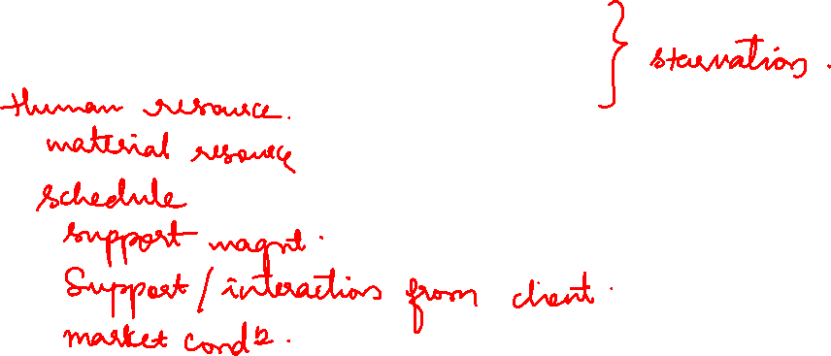
Various types of project termination
Termination by Starvation
It is “slow starvation by budget decrement
Withdrawal of “life support”
Can save “face,” avoid embarrassment, evade admission of defeat

Slide 19

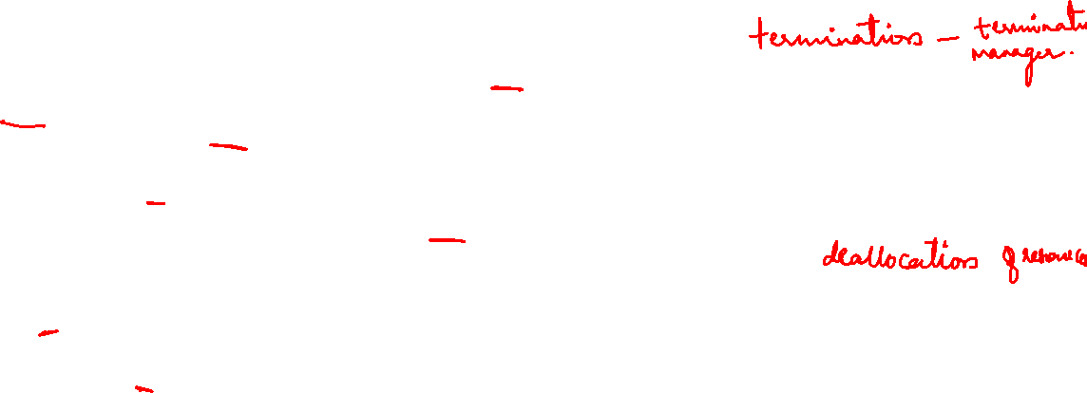
The primary duties of the termination manager are encompassed in the following nine general tasks
Ensure completion of the work, including tasks performed by subcontractors.
Notify the client of project completion and ensure that delivery (and installation) is accomplished. Acceptance of the
project must be acknowledged by the client.
Ensure that documentation is complete, including a terminal evaluation of the project deliverables and preparation of
the project’s Final Report.
Clear for fi nal billings and oversee preparation of the fi nal invoices sent to the client.
Redistribute personnel, materials, equipment, and any other resources to the appropriate places.
Clear project with legal counsel or consultant. File for patents if appropriate. Record and archive all “nondisclosure”
documents.
Determine what records (manuals, reports, and other paperwork) to keep. Ensure that such documents are stored in
the proper places and that responsibility for document retention is turned over to the parent organization’s archivist.
Ascertain any product support requirements (e.g., spares, service), decide how such support will be delivered, and assign responsibility.
Oversee the closing of the project’s books.

Slide 20
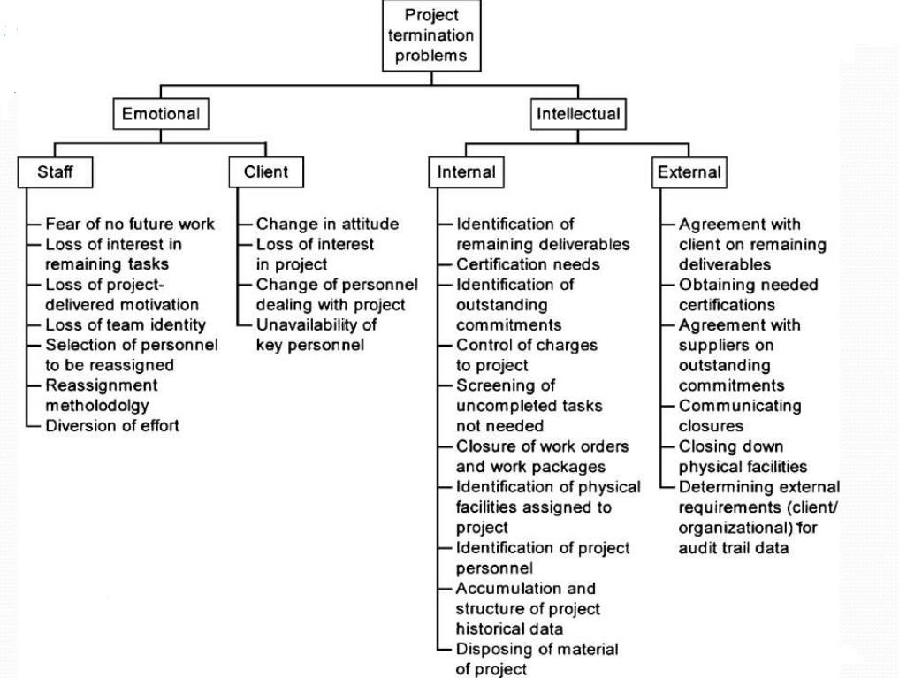

Slide 21
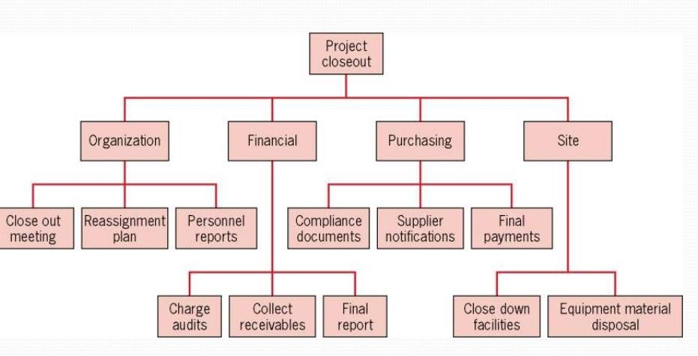

A Design for Project Termination

Slide 22
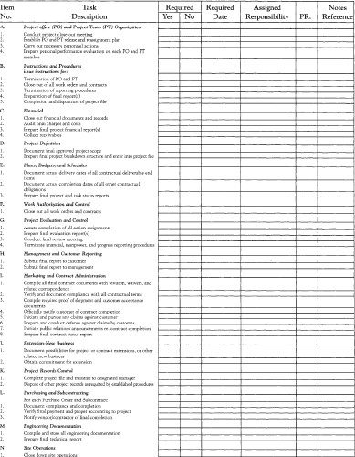
Checklist for project termination

Slide 23
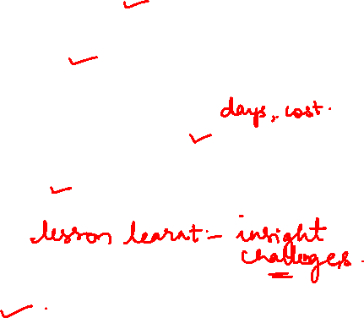
Formally transfer all deliverables
Process Of Project Termination
confirm project completion
Review all contracts and documentation
release resources
conduct post-mortem
archive documentation

Slide 24






PROJECT PERFORMANCE
COMPLETING A FINAL REPORT
ADMINISTRATIVE PERFORMANCE
ORGANIZATIONAL STRUCTURE
PROJECT AND ADMINISTRATIVE TEAM
METHODS OF PROJECT MANAGEMENT

Slide 25





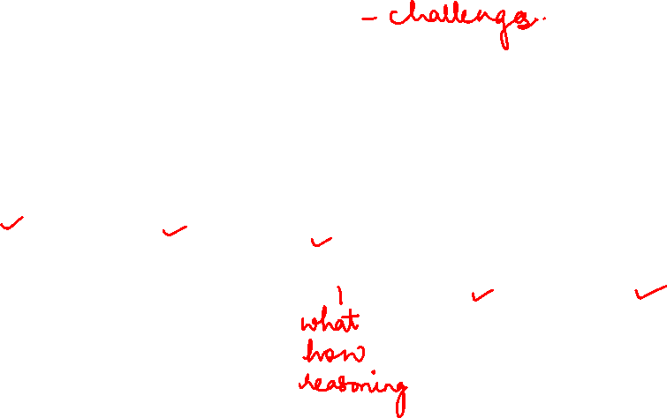
Lessons Learned Analysis
IDENTIFY
DOCUMENT
ANALYSE
STORE
RETRIEVE

Slide 26
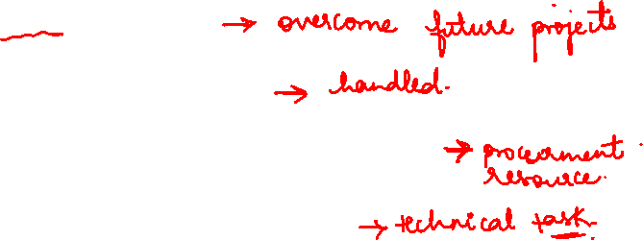
Communication weakness
Common Areas Of Lessons Learned
Management of risk and issues
Obtaining the right resource to get the job done
Clarity around roles and responsibilities
Management benefits
Knowing when and how to stop a failing project

Slide 27
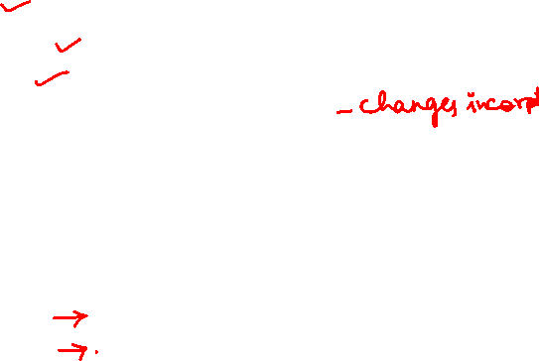
How to identify lessons learned?
Call the meeting
Invite the right people
A point of felicitator
Revisit the objectives and deliverables of the project
Go through the project step by step
Ask a why question
Identify the positive
Identify the missed opportunities
Ensure that participant leave with their feelings acknowledge
Record the meeting

Slide 28


acknowledging the success and failure
Causes of project failure
Courses of project success

Slide 29


PROJECT MANAGEMENT TEMPLATES
https://www.projectmanagementdocs.com

Slide 30
The main source of authority is sponsor
MANAGING WITHOUT AUTHORITY
Develop online link between sponsor and project field
Delegate duties and responsibilities
Develop weekly reports

